Slide 1
Black Hole Attack
Detection System using SVM
Team Members:
Mageshwaran M - 127158029
Dhiyaneshwar P V - 127158010
Yuvanesh Sasikumar - 127158061

Slide 2
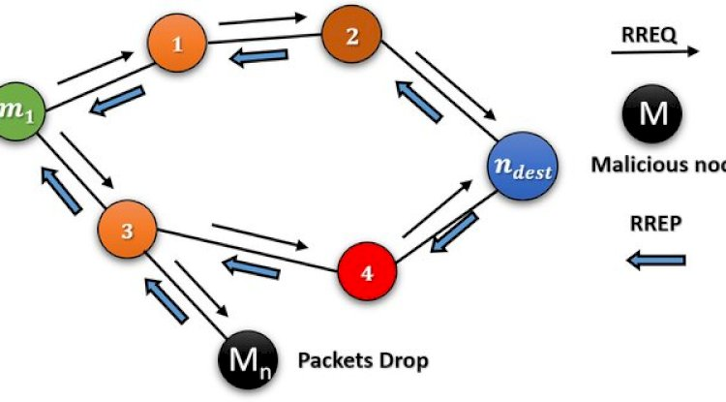

Problem Statement
Mobile Ad-hoc Networks (MANETs) are decentralized and infrastructure-less, making them highly vulnerable to routing attacks.
•
Black Hole Attack: A malicious node falsely advertises the shortest path to a destination during the route discovery process.
•
Impact: Once the route is established, the node silently drops all data packets, causing 100% data loss and network disruption.
•
Challenge: Detecting these nodes in real-time without compromising network performance is difficult due to the dynamic topology.

Slide 3


Literature Survey & Research Gap
Primary Reference
Identified Gap Analysis
Abdallah et al. (2024)
International Information & Engineering Technology Association (IIETA)
While theoretical models achieve high accuracy, current research lacks practical implementation tools.
Focus: Proposed the ADS-SVM model (Anomaly Detection System using Support Vector Machines).
Modern Integration: Lack of Python-based, lightweight implementations suitable for modern dashboards.
Technique: Utilized a Radial Basis Function (RBF) Kernel to handle non-linear data patterns.
Visualization: Absence of real-time visual feedback for immediate threat assessment.
Key Result: Achieved 99.96% detection accuracy in controlled simulations.

Slide 4


Proposed Methodology
1. Detection Engine (Backend)
2. Real-Time Monitor (Frontend)
We will implement the Support Vector Machine (SVM) algorithm with an RBF kernel, as recommended by Abdallah et al.
A live detection system bridging the gap between theory and practice.
Capture: Python Scapy library to sniff live network packets.
Features: Packet Delivery Ratio (PDR) and Throughput.
Visualization: Streamlit dashboard to display network health and flag malicious IPs instantly.
Training: Using the UNR-IDD dataset

Slide 5
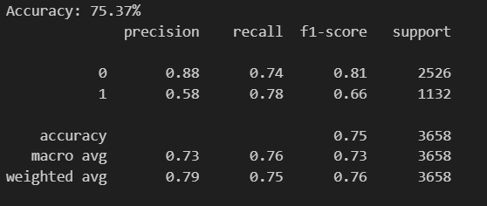
Technical Implementation Progress
Dataset: Transitioned from NSL-KDD (Generic) to UNR-IDD (Network Intrusion Dataset) for better SDN/MANET behavior relevance.
Core Model: SVM with Radial Basis Function (RBF) Kernel.
Feature Engineering: Focused on 13 behavioral features (Deltas, Throughput, and Flow entries) to eliminate data leakage found in cumulative packet counts
Experimental Results (Current Stage): Model accuracy of 75.37% achieved after removing leaky cumulative features and room to improve.

Slide 6
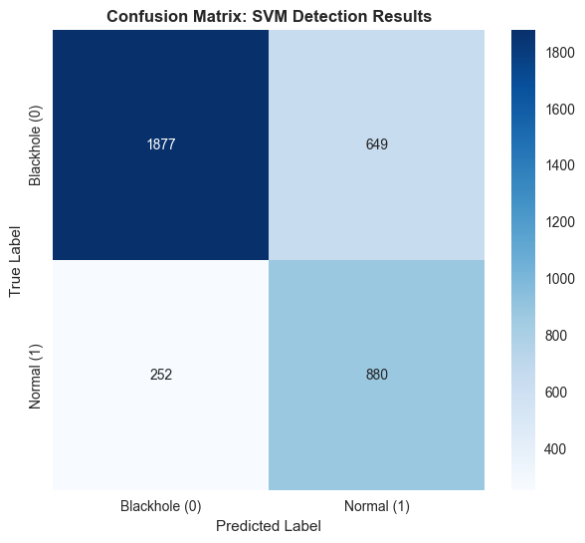
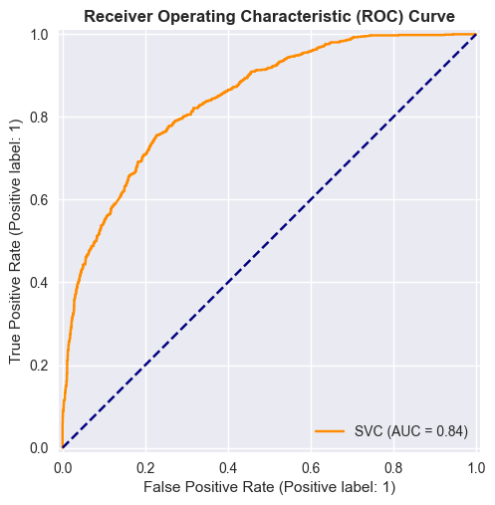
Output Metrics

Slide 7
System Architecture and Progress (Prototype)
Sniffer Engine (Scapy): Performs live capture of inbound (RX) and outbound (TX) traffic to detect packet absorption.
Real-time Logic: Uses Bi-directional Symmetry Analysis to distinguish between high-bandwidth legitimate traffic (Speed Tests) and Black Hole attacks.
Dashboard (Streamlit): A live interface displaying node identity (IP/MAC), estimated PDR, and real time analytics

Slide 8
Project Timeline & Work Plan
Phase 1
Phase 2
Phase 3
Phase 4
Literature Survey & Dataset Collection
SVM Model Training
Real-Time Packet Sniffer Integration
Final Testing, Dashboard UI, & Reporting

Slide 9
Further Work Plan
Incorporate more feature engineering techniques and training methods to improve testing accuracy
Demonstrate the working of the model on a real traffic using packet sniffing and simulate a fake black hole node.
More detailed dashboard analytics using more metrics analysed in real time.

